Slide 1
Chapter 2 Objectives
The CCNA Topics Covered in this chapter include:
  What is STP?
  STP operation
  STP port states

Slide 2
Spanning-Tree Protocol (STP)
Redundancy in a network is extremely important because redundancy allows networks to be fault tolerant.
Redundant topologies based on switches and bridges are subject to broadcast storms, multiple frame transmissions, and MAC address database instability.
Therefore network redundancy requires careful planning and monitoring to function properly.
The Spanning-Tree Protocol is used in switched networks to create a loop free network

Slide 3
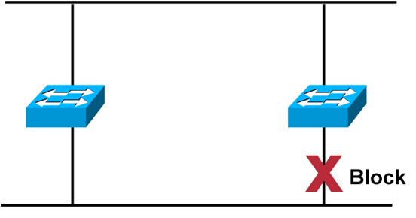
Spanning-Tree Protocol
  Provides a loop-free redundant network topology by
  placing certain ports in the blocking state.
Spanning Tree Protocol resides in Data link Layer
Ethernet bridges and switches can implement the IEEE 802.1D Spanning-Tree Protocol and use the spanning-tree algorithm to construct a loop free network.

Slide 4
Selecting the Root Bridge
The first decision that all switches in the network make, is to identify the root bridge.
When a switch is turned on, the spanning-tree algorithm is used to identify the root bridge. BPDUs are sent out with the Bridge ID (BID).
The BID consists of a bridge priority that defaults to 32768 and the switch base MAC address.
When a switch first starts up, it assumes it is the root switch and sends BPDUs. These BPDUs contain BID.
All bridges see these and decide that the bridge with the smallest BID value will be the root bridge.
A network administrator may want to influence the decision by setting the switch priority to a smaller value than the default.

Slide 5
Spanning Tree Protocol Terms
BPDU Bridge Protocol Data Unit (BPDU) - All the switches exchange information to use in the selection of the root switch
Bridge ID - The bridge ID is how STP keeps track of all the switches in the network. It is determined by a combination of the bridge priority (32,768 by default on all Cisco switches) and the base MAC address.
Root Bridge -The bridge with the lowest bridge ID becomes the root bridge in the network.
Nonroot bridge - These are all bridges that are not the root bridge.
Root port - The root port is always the link directly connected to the root bridge or the shortest path to the root bridge. If more than one link connects to the root bridge, then a port cost is determined by checking the bandwidth of each link.
Designated port - A designated port is one that has been determined as having the best (lowest) cost. A designated port will be marked as a forwarding port
Nondesignated Port - A nondesignated port is one with a higher cost than the designated port. Nondesignated ports are put in blocking mode
Forwarding Port - A forwarding port forwards frames
Blocked Port - A blocked port is the port that will not forward frames, in order to prevent loops

Slide 6
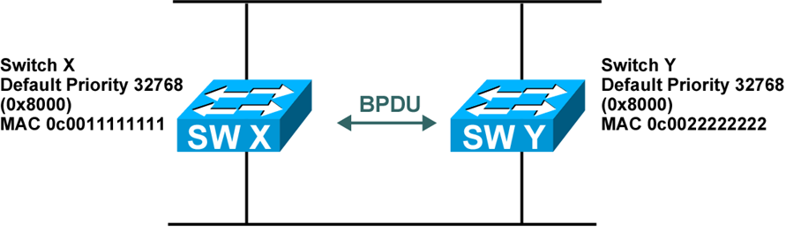

STP Root Bridge Selection
BPDU = Bridge Protocol Data Unit
(default = sent every two seconds)
Root bridge = Bridge with the lowest bridge ID
Bridge ID =
In the example, which switch has the lowest bridge ID?

Slide 7
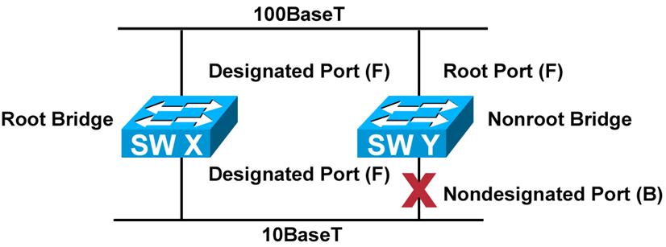
Spanning Tree Operation
One root bridge per network
One root port per non-root bridge
One designated port per segment
Nondesignated ports are unused

Slide 8
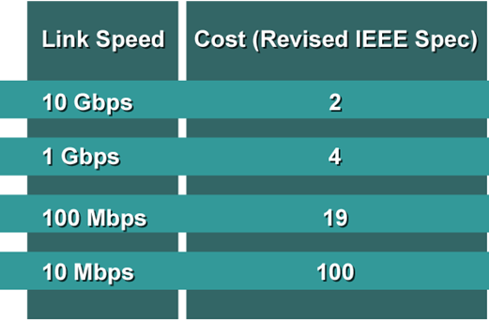
Selecting the Root Port
The STP cost is an accumulated total path cost based on the rated bandwidth of each of the links
This information is then used internally to select the root port for that device

Slide 9
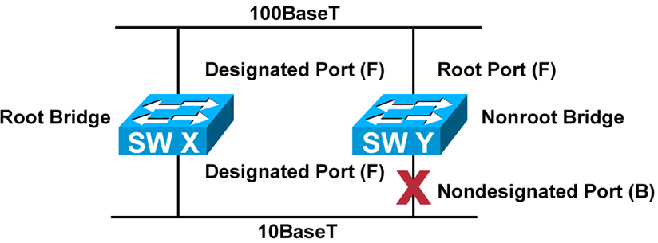
Spanning Tree Operation
One root bridge per network
One root port per non-root bridge
One designated port per segment
Nondesignated ports are unused
19
100

Slide 10
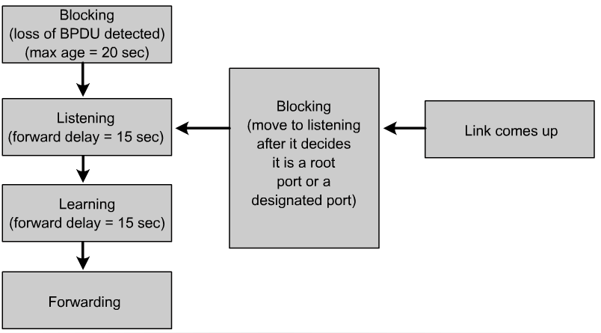
Spanning-Tree Port States
  Spanning-tree transits each port through several different states:

Slide 11
Three Steps of Initial STP Convergence
The STP algorithm uses three simple steps to converge on a loop-free topology.
Switches go through three steps for their initial convergence:
STP Convergence
Step 1 Elect one Root Bridge
Step 2 Elect Root Ports
Step 3 Elect Designated Ports
All STP decisions are based on a the following predetermined sequence:
Four-Step decision Sequence
Step 1 - Lowest BID
Step 2 - Lowest Path Cost to Root Bridge
Step 3 - Lowest Sender BID
Step 4 - Lowest Port ID

Slide 12
Three Steps of Initial STP Convergence
STP Convergence
Step 1 Elect one Root Bridge
Step 2 Elect Root Ports
Step 3 Elect Designated Ports

Slide 13
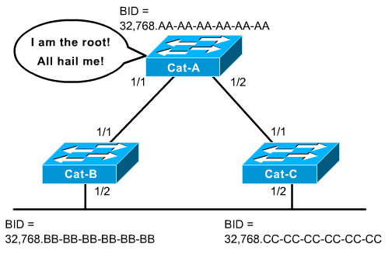
Step 1 Elect one Root Bridge
Cat-A has the lowest Bridge MAC Address, so it wins the Root War!
All 3 switches have the same default Bridge Priority value of 32,768

Slide 14
Step 1 Elect one Root Bridge
2950#show spanning-tree
VLAN0001
Spanning tree enabled protocol ieee
Root ID Priority 32768
Address 0003.e334.6640
Cost 19
Port 23 (FastEthernet0/23)
Hello Time 2 sec Max Age 20 sec Forward Delay 15 sec
Bridge ID Priority 32769 (priority 32768 sys-id-ext 1)
Address 000b.fc28.d400
Hello Time 2 sec Max Age 20 sec Forward Delay 15 sec
Aging Time 300
Interface Port ID Designated Port ID
Name Prio.Nbr Cost Sts Cost Bridge ID Prio.Nbr
---------------- -------- --------- --- --------- -------------------- --------
Fa0/23 128.23 19 FWD 0 32768 0003.e334.6640 128.25
ALSwitch#

Slide 15
Three Steps of Initial STP Convergence
STP Convergence
Step 1 Elect one Root Bridge
Step 2 Elect Root Ports
Step 3 Elect Designated Ports

Slide 16
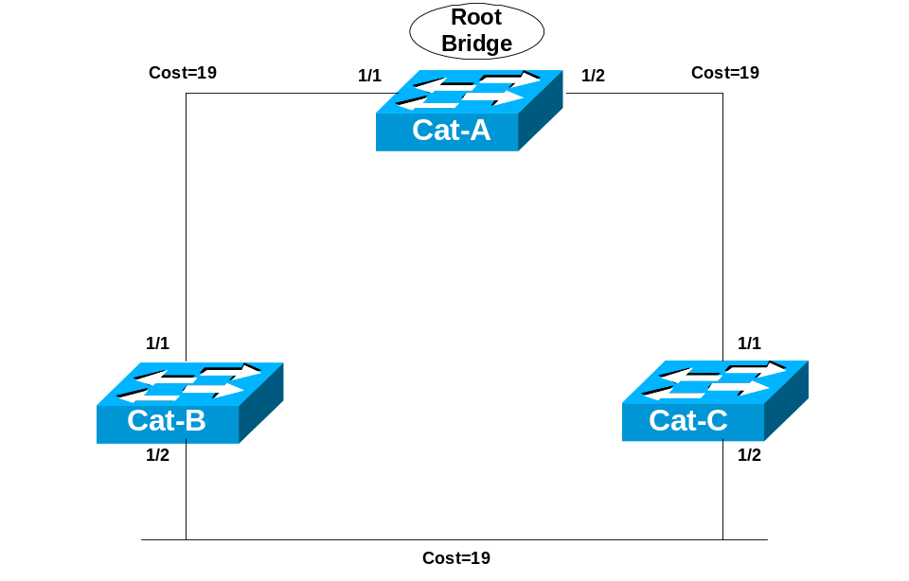
Step 2 Elect Root Ports
Now that the Root War has been won, switches move on to selecting Root Ports.
A bridge’s Root Port is the port closest to the Root Bridge.
Bridges use the cost to determine closeness.
Every non-Root Bridge will select one Root Port!
Specifically, bridges track the Root Path Cost, the cumulative cost of all links to the Root Bridge.

Slide 17
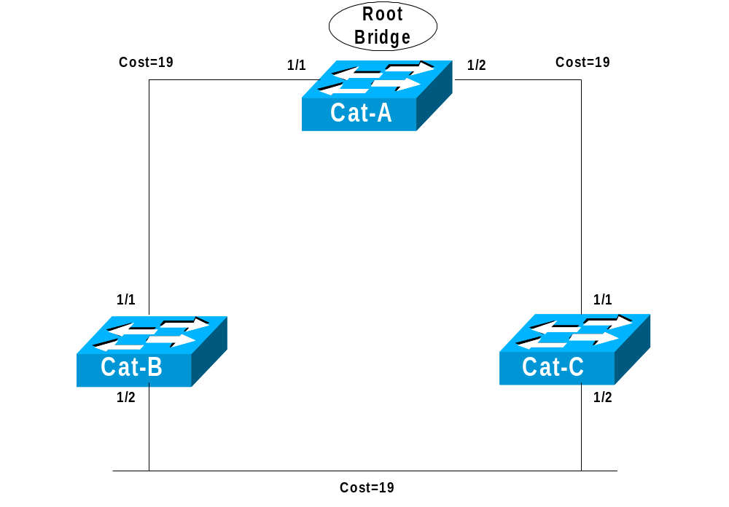
Step 2 Elect Root Ports
Step 1
Cat-A sends out BPDUs, containing a Root Path Cost of 0.
Cat-B receives these BPDUs and adds the Path Cost of Port 1/1 to the Root Path Cost contained in the BPDU.
Step 2
Cat-B adds Root Path Cost 0 PLUS its Port 1/1 cost of 19 = 19

Slide 18
Step 2 Elect Root Ports
Step 3
Cat-B uses this value of 19 internally and sends BPDUs with a Root Path Cost of 19 out Port 1/2.
Step 4
Cat-C receives the BPDU from Cat-B, and increased the Root Path Cost to 38 (19+19). (Same with Cat-C sending to Cat-B.)

Slide 19
Step 2 Elect Root Ports
Step 5
Cat-B calculates that it can reach the Root Bridge at a cost of 19 via Port 1/1 as opposed to a cost of 38 via Port 1/2.
Port 1/1 becomes the Root Port for Cat-B, the port closest to the Root Bridge.
Cat-C goes through a similar calculation. Note: Both Cat-B:1/2 and Cat-C:1/2 save the best BPDU of 19 (its own).

Slide 20
Step 2 Elect Root Ports
2950#show spanning-tree
VLAN0001
Spanning tree enabled protocol ieee
Root ID Priority 32768
Address 0003.e334.6640
Cost 19
Port 23 (FastEthernet0/23)
Hello Time 2 sec Max Age 20 sec Forward Delay 15 sec
Bridge ID Priority 32769 (priority 32768 sys-id-ext 1)
Address 000b.fc28.d400
Hello Time 2 sec Max Age 20 sec Forward Delay 15 sec
Aging Time 300
Interface Port ID Designated Port ID
Name Prio.Nbr Cost Sts Cost Bridge ID Prio.Nbr
---------------- -------- --------- --- --------- -------------------- --------
Fa0/23 128.23 19 FWD 0 32768 0003.e334.6640 128.25
ALSwitch#

Slide 21
Three Steps of Initial STP Convergence
STP Convergence
Step 1 Elect one Root Bridge
Step 2 Elect Root Ports
Step 3 Elect Designated Ports

Slide 22
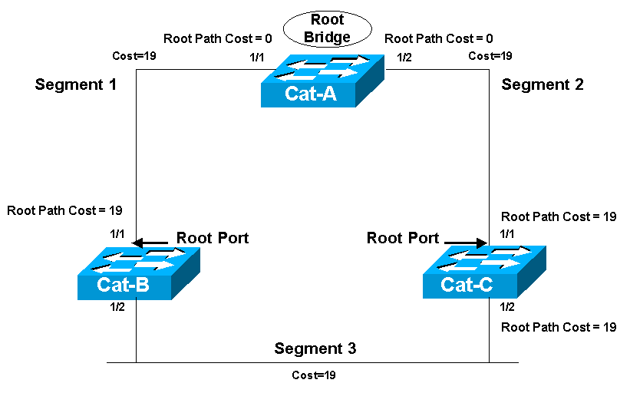
Step 3 Elect Designated Ports
The loop prevention part of STP becomes evident during this step, electing designated ports.
A Designated Port functions as the single bridge port that both sends and receives traffic to and from that segment and the Root Bridge.
Each segment in a bridged network has one Designated Port, chosen based on cumulative Root Path Cost to the Root Bridge.
To locate Designated Ports, lets take a look at each segment.
Root Path Cost, the cumulative cost of all links to the Root Bridge.

Slide 23
Step 3 Elect Designated Ports
Root Path Cost = 0
Root Path Cost = 0
Segment 1
Segment 2
Root Path Cost = 19
Root Path Cost = 19
Root Port
Root Port
Root Path Cost = 19
Root Path Cost = 19
Segment 3
Segment 1: Cat-A:1/1 has a Root Path Cost = 0 (after all it has the Root Bridge) and Cat-B:1/1 has a Root Path Cost = 19.
Segment 2: Cat-A:1/2 has a Root Path Cost = 0 (after all it has the Root Bridge) and Cat-C:1/1 has a Root Path Cost = 19.
Segment 3: Cat-B:1/2 has a Root Path Cost = 19 and Cat-C:1/2 has a Root Path Cost = 19. It’s a tie!

Slide 24
Step 3 Elect Designated Ports
Root Path Cost = 0
Root Path Cost = 0
Segment 1
Segment 2
Designated Port
Designated Port
Root Path Cost = 19
Root Path Cost = 19
Root Port
Root Port
Root Path Cost = 19
Root Path Cost = 19
Segment 3
Segment 1
Because Cat-A:1/1 has the lower Root Path Cost it becomes the Designate Port for Segment 1.
Segment 2
Because Cat-A:1/2 has the lower Root Path Cost it becomes the Designate Port for Segment 2.

Slide 25
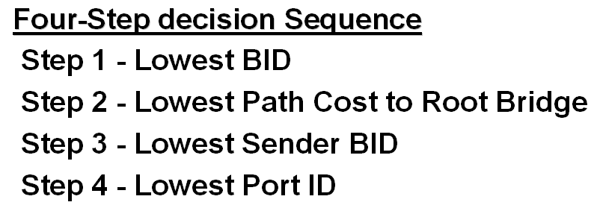
Step 3 Elect Designated Ports
Root Path Cost = 0
Root Path Cost = 0
Segment 1
Designated Port
Segment 2
Designated Port
Root Path Cost = 19
Root Path Cost = 19
Root Port
Root Port
32,768.CC-CC-CC-CC-CC-CC
32,768.BB-BB-BB-BB-BB-BB
Root Path Cost = 19
Segment 3
Non-Designated Port
Root Path Cost = 19
Designated Port
Segment 3 (continued)
1) All three switches agree that Cat-A is the Root Bridge, so this is a tie.
2) Root Path Cost for both is 19, also a tie.
3) The sender’s BID is lower on Cat-B, than Cat-C, so Cat-B:1/2 becomes the Designated Port for Segment 3.
Cat-C:1/2 therefore becomes the non-Designated Port for Segment 3.

Slide 26
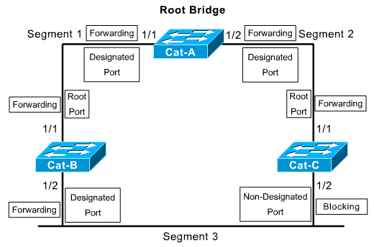
STP Port States
In the blocking state, ports can only receive BPDUs.
  Data frames are discarded and no addresses can be learned.
  It may take up to 20 seconds to change from this state.
Ports go from the blocked state to the listening state.
  Switch determines if there are any other paths to the root bridge.
  The path that is not the least cost path to the root bridge goes back to the blocked state.
  The listening period is called the forward delay and lasts for 15 seconds.
  In the listening state, user data is not being forwarded and MAC addresses are not being learned.
  BPDUs are still processed.

Slide 27
STP Port States
Ports transition from the listening to the learning state.
  In this state user data is not forwarded, but MAC addresses are learned from any traffic that is seen.
  The learning state lasts for 15 seconds and is also called the forward delay.
  BPDUs are still processed.

Slide 28
STP Port States
A port goes from the learning state to the forwarding state.
  In this state user data is forwarded and MAC addresses continue to be learned.
  BPDUs are still processed.
Remember – A switch port is allowed to transition to the Forwarding state only if no redundant links (loops) are detected and if the port has the best path to the Root Bridge as the Root Port or Designated Port.

Slide 29
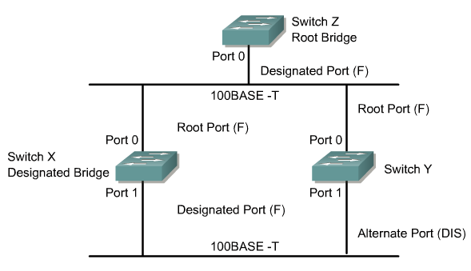
Rapid Spanning Tree Protocol (RSTP)
The Rapid Spanning-Tree Protocol is defined in the IEEE 802.1w LAN standard.
The standard and protocol introduce the following:
  Clarification of port states and roles
  Definition of a set of link types that can go to forwarding state rapidly
The “blocked” state of a port has been renamed as the “discarding” state.

